Slide 1
Programming 101 Day 2
HTML Styling

Slide 2
Outline
HTML Styling with CSS
Layouting

Slide 3
HTML Styling with CSS

Slide 4
What is CSS?
CSS stands for Cascading Style Sheets
CSS describes how HTML elements are to be displayed on screen, paper, or in other media
CSS saves a lot of work. It can control the layout of multiple web pages all at once
External stylesheets are stored in CSS files

Slide 5


Slide 6
CSS can be added to HTML elements in 3 ways:
Inline - by using the style attribute in HTML elements
Internal - by using a <style> element in the <head> section
External - by using an external CSS file

Slide 7
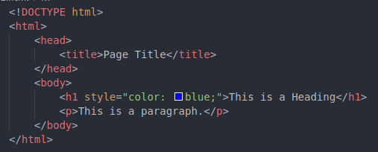
Inline

Slide 8
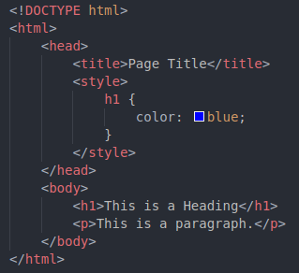
Internal

Slide 9
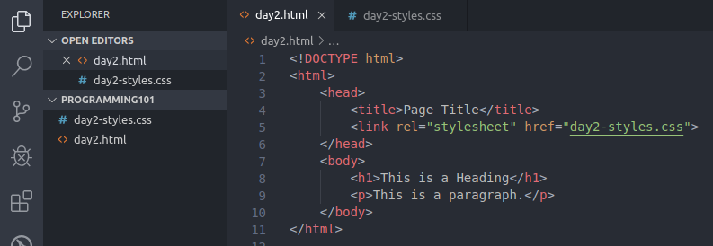
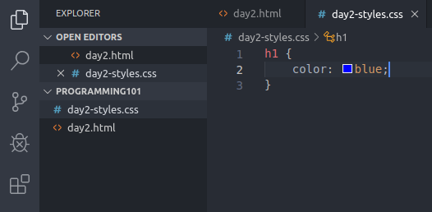
External

Slide 10
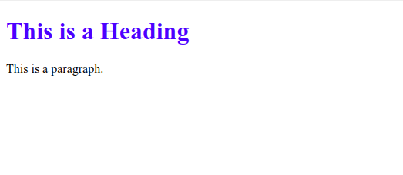
Same Result

Slide 11
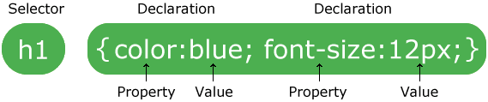
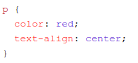
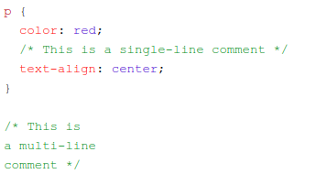
CSS Syntax
Example

Slide 12
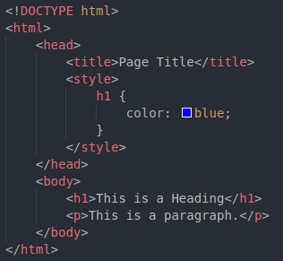
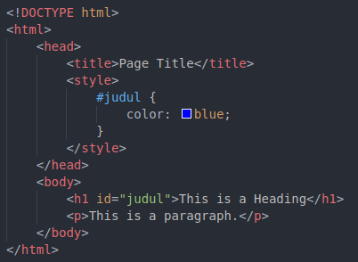
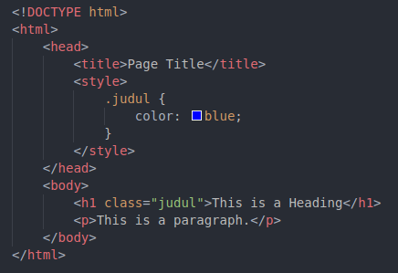
CSS Syntax
Selectors

Slide 13
Same Result

Slide 14
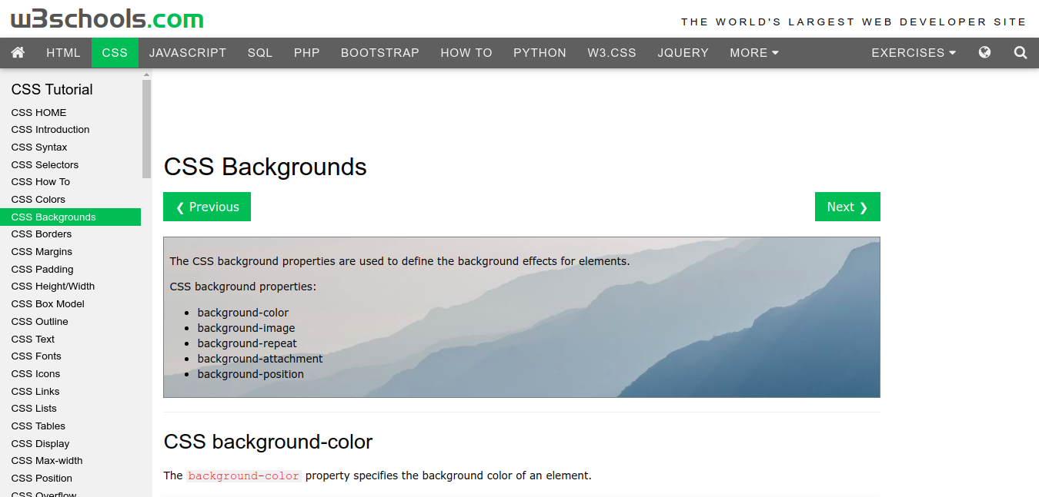
Check more CSS properties at https://www.w3schools.com/css/

Slide 15
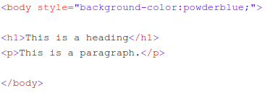
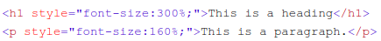
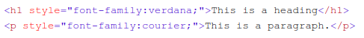
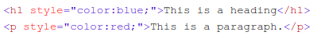
Style

Slide 16
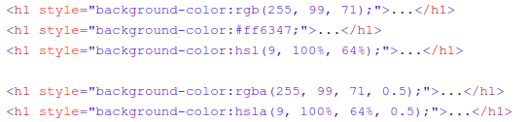
Colors

Slide 17
Try it!
Add some style to your article from Day1!

Slide 18
Layouting

Slide 19
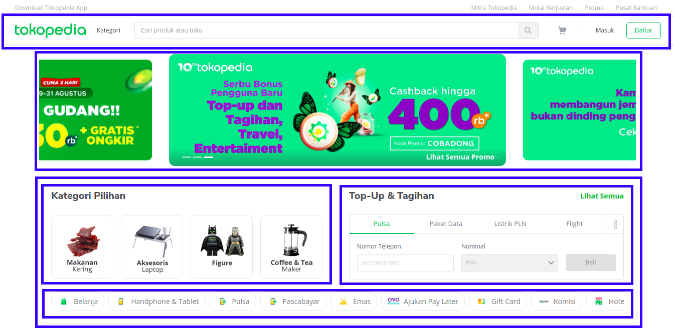

Slide 20
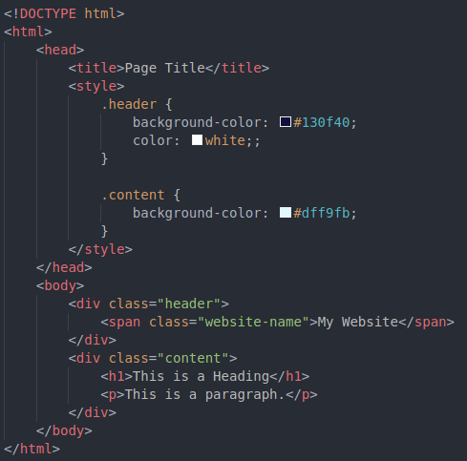
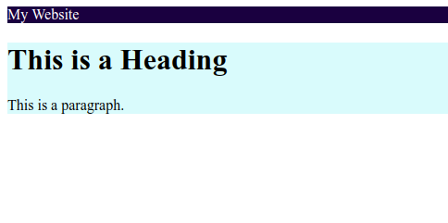
Grouping with <div> tag!

Slide 21
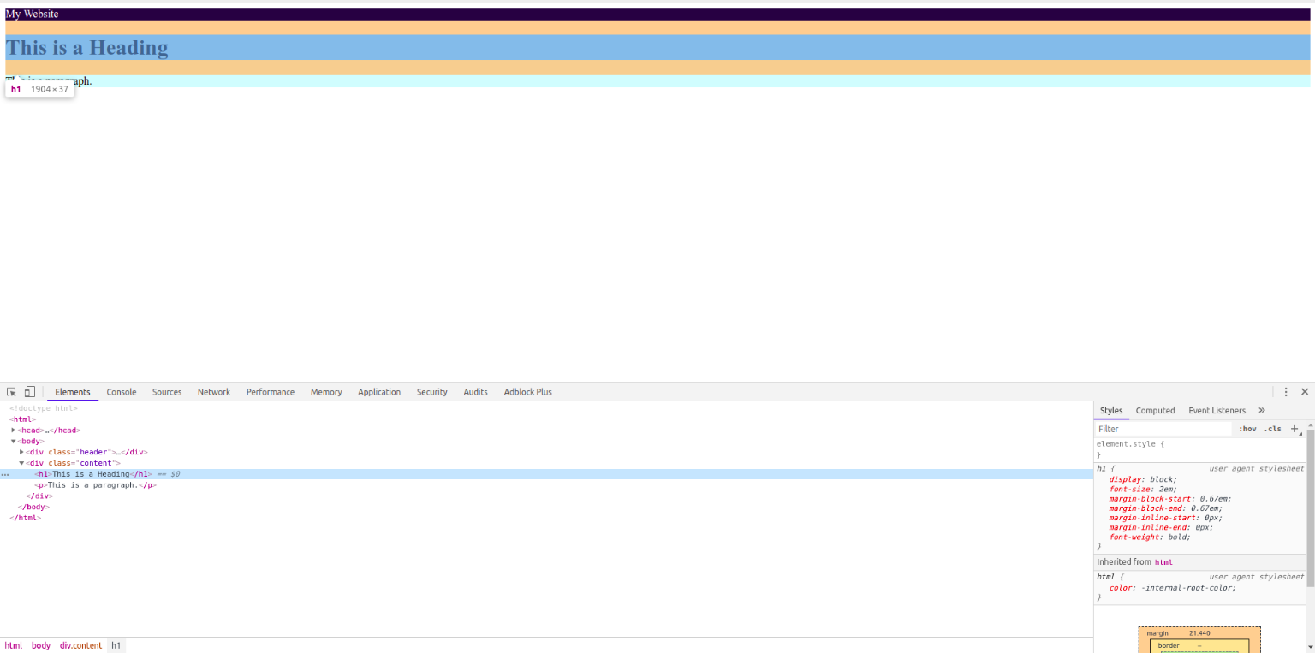
Inspect Element in Browser

Slide 22
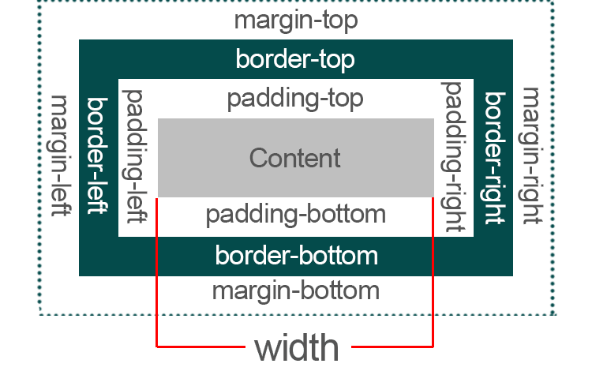
Margin Padding

Slide 23
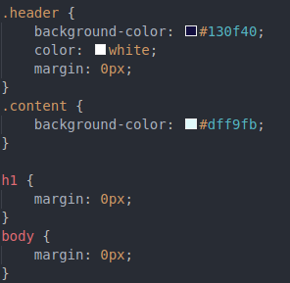
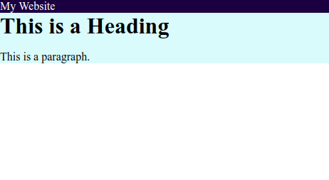
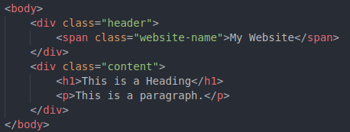
Remove the margin

Slide 24
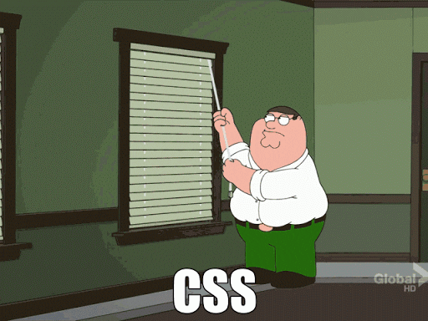

Slide 25
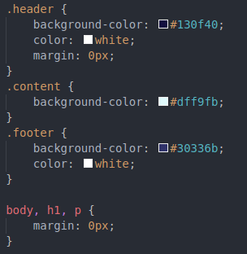
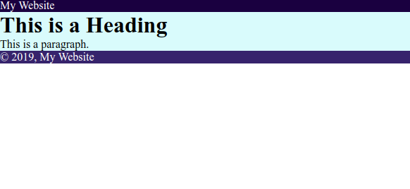
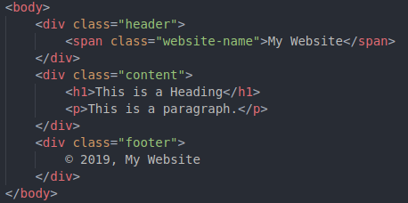
Add footer

Slide 26
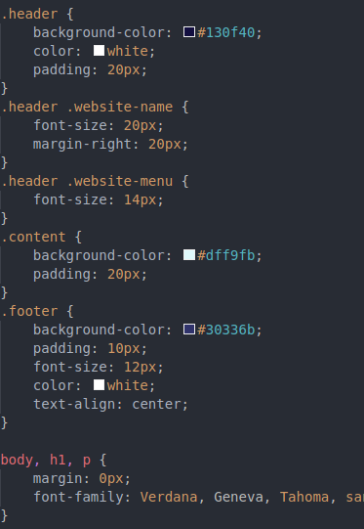
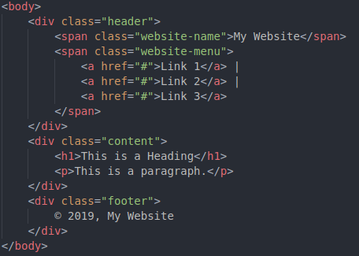
Make it better! (Add margin & change font size & font family)

Slide 27
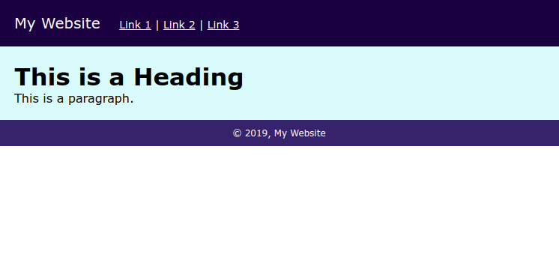
Make it better! (Add margin & change font size & font family)

Slide 28
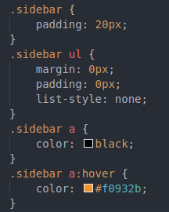
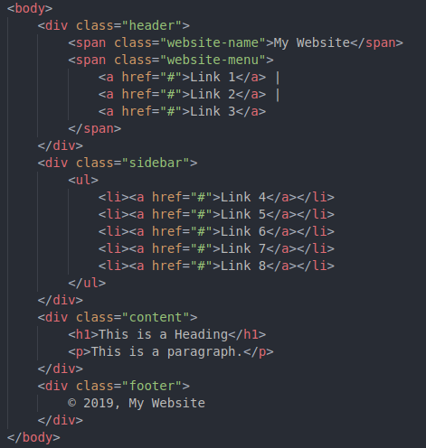
Add sidebar (part 1)

Slide 29
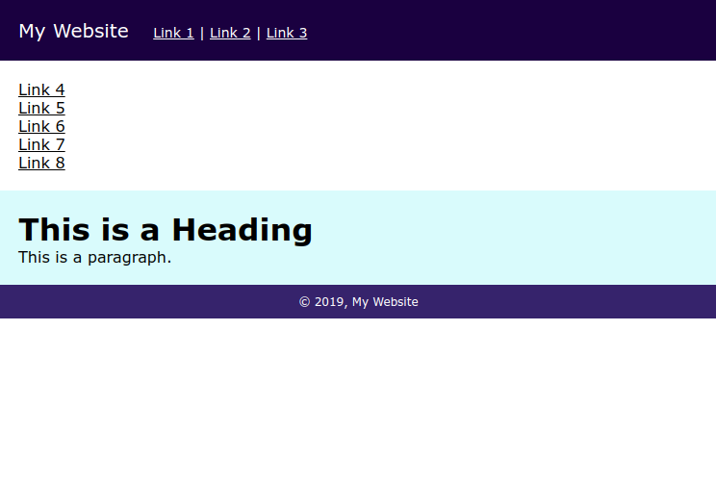

Slide 30
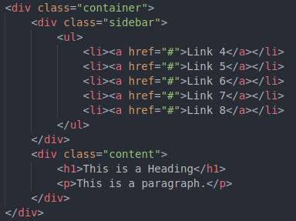
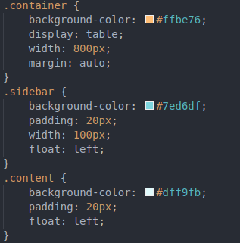
Add sidebar (part 2)

Slide 31
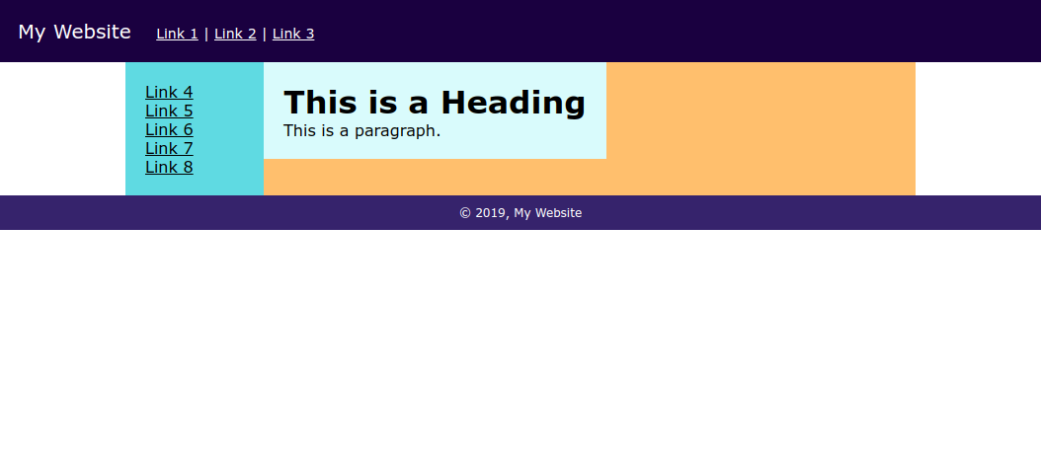

Slide 32
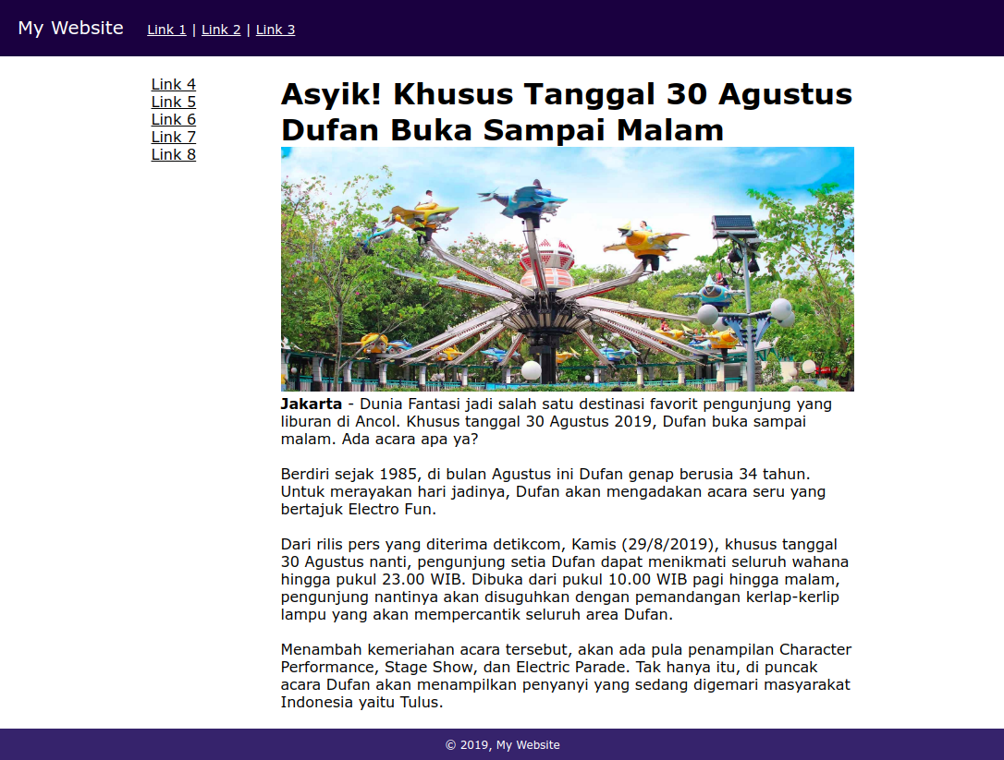
Create your own static website!
Choose an article from Internet
Create your own website, styles and layout
Put the article to your website. Like the example -->

Slide 33
“There is no shortcut to anyplace worth going”
- Beverly Sills

